Slide 1
Chapter 10
Information Security Management
Notes:
This chapter provides an overview of the major components of information systems security.

Slide 2
“But How Do You Implement That Security?”
Video conference with potential PRIDE promoter and advertiser
PRIDE originally designed to store medical data
SDS wants to know if PRIDE systems has acceptable level of security
Doesn’t want to affiliate with company with major security problem
Criminals now focus attacks on inter-organizational systems
Notes:
GOALS
Illustrate the meaning of design for privacy and security.
Illustrate a use for knowledge of cardinality.
Set up a class discussion about how much technical language to use in management/IS professional meetings.
Using the N:M relationship:
Let’s go back to Chapter 5. What is an N:M relationship?
Give me several examples of N:M relationship in business.
How is an N:M relationship represented in a database?
Explain why the relationship between patients and doctors is N:M.
Using Figure 7-18, How is that relationship represented in the PRIDE database?

Slide 3
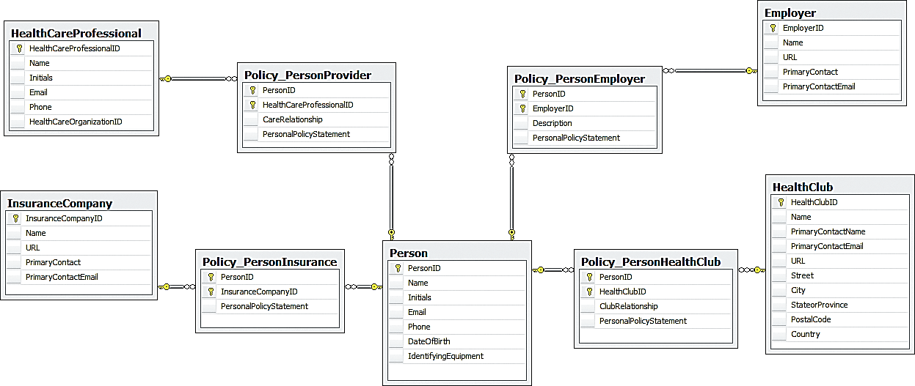
PRIDE Design for Security
Notes:
M:N tables with Person as intersecting security table.

Slide 4
Study Questions
Q1: What is the goal of information systems security?
Q2: How big is the computer security problem?
Q3: How should you respond to security threats?
Q4: How should organizations respond to security threats?
Q5: How can technical safeguards protect against security threats?
Q6: How can data safeguards protect against security threats?
Q7: How can human safeguards protect against security threats?
Q8: How should organizations respond to security incidents?
How does the knowledge in this chapter help you?
Notes:
This chapter provides an overview of the major components of information systems security.

Slide 5
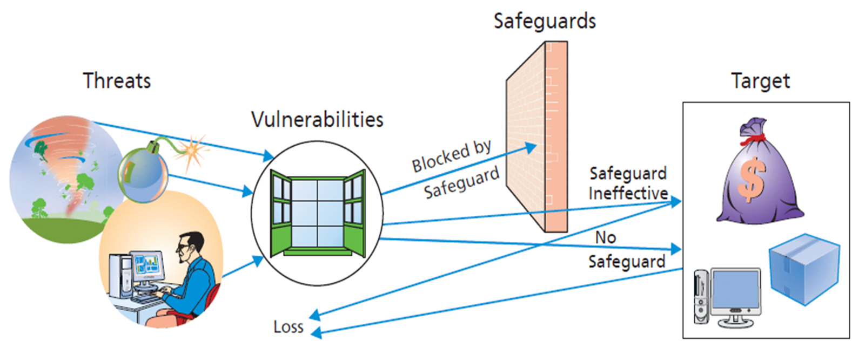
Q1: What Is the Goal of Information Systems Security?
Notes:
Threat/Loss Scenario: Major elements of IS security
Threat – person or organization seeks to obtain data or other assets illegally, without owner’s permission and often without owner’s knowledge
Vulnerability – opportunity for threats to gain access to individual or organizational assets; for example, when you buy online, you provide your credit card data, and as data is transmitted over Internet, it is vulnerable to threats
Safeguard – measure individuals or organizations take to block threat from obtaining an asset; not always effective, some threats achieve their goal in spite of safeguards
Target – asset desired by threat

Slide 6
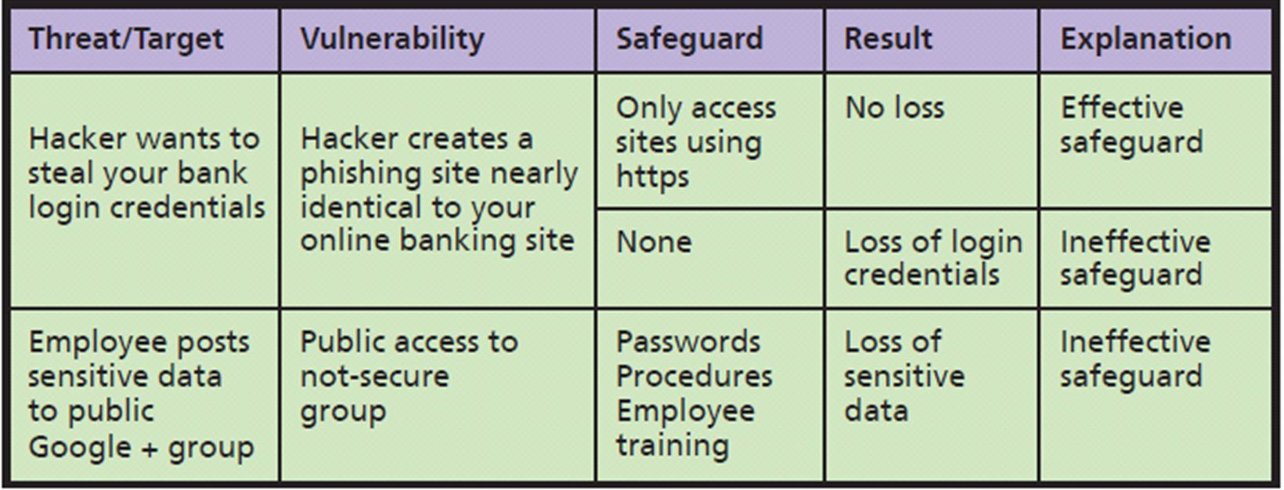
Examples of Threat/Loss
Notes:
If you access what appears to be your bank’s site without using https (i.e., an unsecured site), you have no safeguard at all. Your login credentials can be quickly recorded and resold to other criminals.
The employer has procedures that state employees are not to post confidential data to any public site, such as Google+, but these procedures were either unknown or ignored.
A third safeguard is the training that all employees are given.

Slide 7
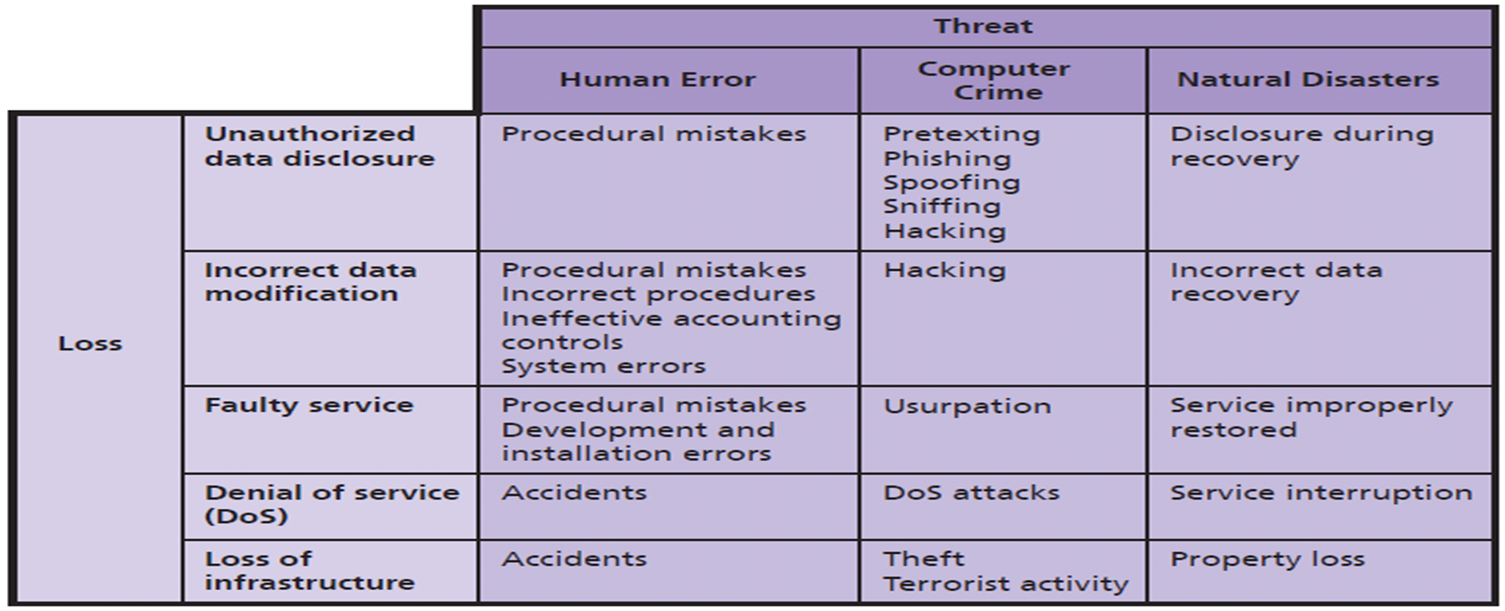
What Are the Sources of Threats?
Notes:
Sources of security threats:
Human error examples: (1) employee misunderstands operating procedures and accidentally deletes customer records; (2) employee inadvertently installs an old database on top of current one while doing backing up; (3) physical accidents, such as driving a forklift through wall of a computer room
Computer crime – intentional destruction or theft of data or other system components
Natural disasters – fires, floods, hurricanes, earthquakes, tsunamis, avalanches, other acts of nature; includes initial loss of capability and service, and losses recovery costs

Slide 8
What Types of Security Loss Exists?
Unauthorized Data Disclosure
Pretexting
Phishing
Spoofing
IP spoofing
Email spoofing
Drive-by sniffers
Wardrivers
Hacking & Natural disasters
Notes:
These are common threats associated with unauthorized data disclosure.

Slide 9
Incorrect Data Modification
Procedures incorrectly designed or not followed
Increasing a customer’s discount or incorrectly modifying employee’s salary
Placing incorrect data on company Web site
Improper internal controls on systems
System errors
Faulty recovery actions after a disaster

Slide 10
Faulty Service
Incorrect data modification
Systems working incorrectly
Procedural mistakes
Programming errors
IT installation errors
Usurpation
Denial of service (unintentional)
Denial-of-service attacks (intentional)
Notes:
Faulty service – problems caused by incorrect system operation
Usurpation – occurs when computer criminals invade a computer system and replace legitimate programs with their own unauthorized ones that shut down legitimate application and substitute their own processing to spy, steal and manipulate data, or other purposes
Denial of service – humans inadvertently shut down a Web server or corporate gateway router by starting a computationally intensive application
Denial-of-service attacks – (1) malicious hacker intentionally floods a Web server with millions of bogus service requests; (2) user unintentionally shuts down Web server or corporate gateway router by starting computationally intensive application

Slide 11
Loss of Infrastructure
Human accidents
Theft and terrorist events
Disgruntled or terminated employee
Natural disasters
Advanced Persistent Threat (APT1)
Theft of intellectual property from U.S. firms
Notes:
Examples – bulldozer cutting a conduit of fiber-optic cables or floor buffer crashing into a rack of Web servers.
APT1" based out of Shanghai. In 2014 the U.S. Department of Justice indicted five individuals involved with APT1 for theft of intellectual property from U.S. firms.

Slide 12
Goal of Information Systems Security
Appropriate trade-off between risk of loss and cost of implementing safeguards
Use antivirus software
Deleting browser cookies (Worth it?)
Get in front of security problems by making appropriate trade-offs
Notes:
Deleting browser cookies, will make using your computer more difficult. Is it worth it?

Slide 13
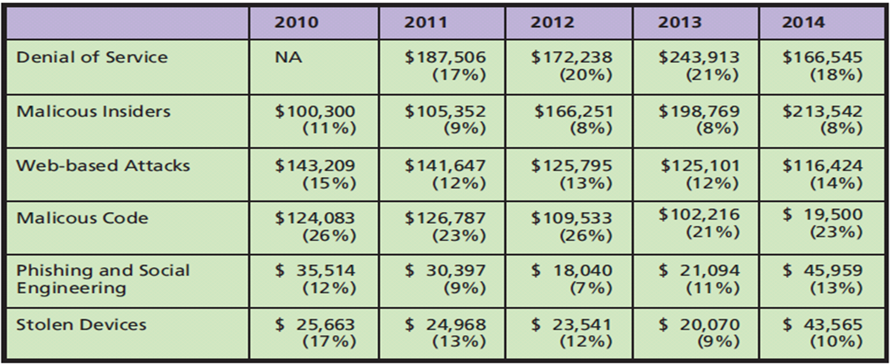
Q2: How Big Is the Computer Security Problem?
Notes:
Average Computer Crime Cost and Percent of Attacks by Type (6 Most Expensive Types).
Figure 10-4 shows the results of a survey done over 2010-2013. It was commissioned by Hewlett-Packard and performed by the Ponemon Institute, a consulting group that specializes in computer crime.
It shows the average cost and percent of total incidents of the six most expensive types of attack. Without variance, median, and tests of significance statistics, it’s difficult to determine if the differences are random.
The number of insider attacks is slightly decreasing, but the average cost of such attacks is increasing, possibly dramatically.
78% of respondents believe negligent or careless employees not following security policies pose a significant risk to their organizations.

Slide 14
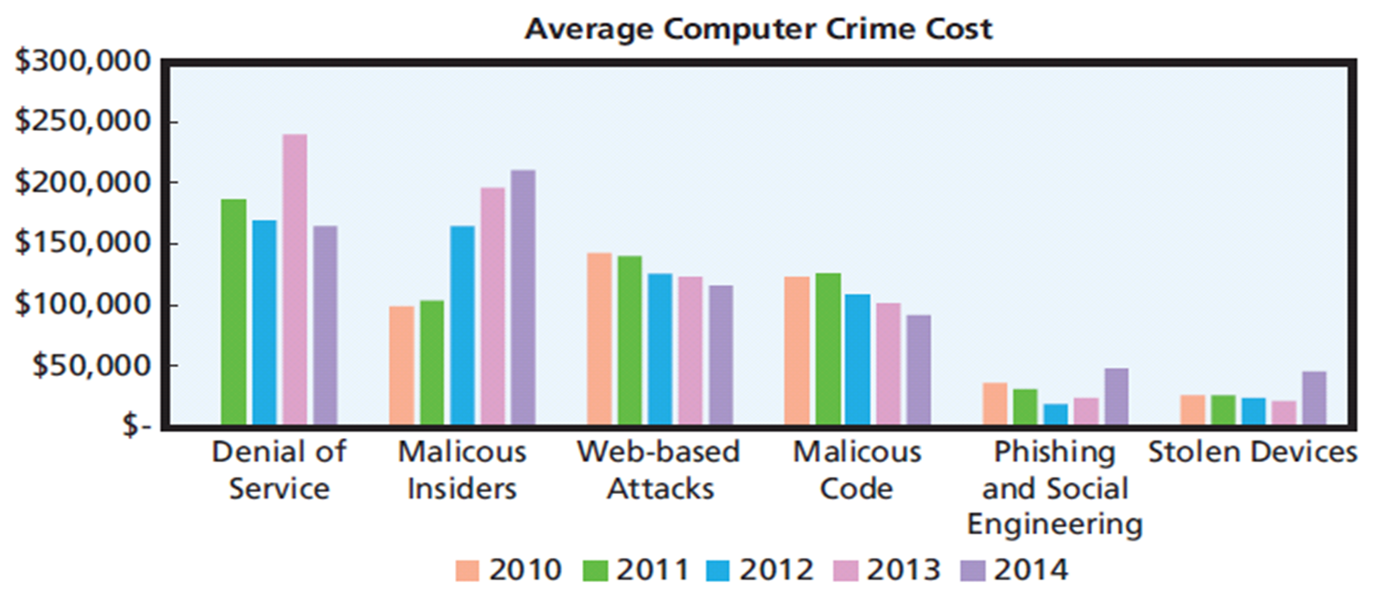
Computer Crime Costs by Attack Type
Notes:
Figure 10-5 .
The 2014 Cost of Computer Crime Study includes an in-depth analysis of the effect of different security policies on the savings in computer crime. Security safeguards are getting more effective.

Slide 15
Ponemon Study Findings (2014)
Malicious insiders increasingly serious threat
Business disruption and data loss principal costs of computer crime
Negligent employees, personal devices connecting to corporate network, use of commercial cloud-based applications pose significant security threats
Security safeguards work
Ponemon Study 2014
Notes:
Warn students that many computer crime studies are based on dubious sampling techniques, and some seem to be written to promote a particular safeguard product or point of view. Be aware of such bias as you read.

Slide 16
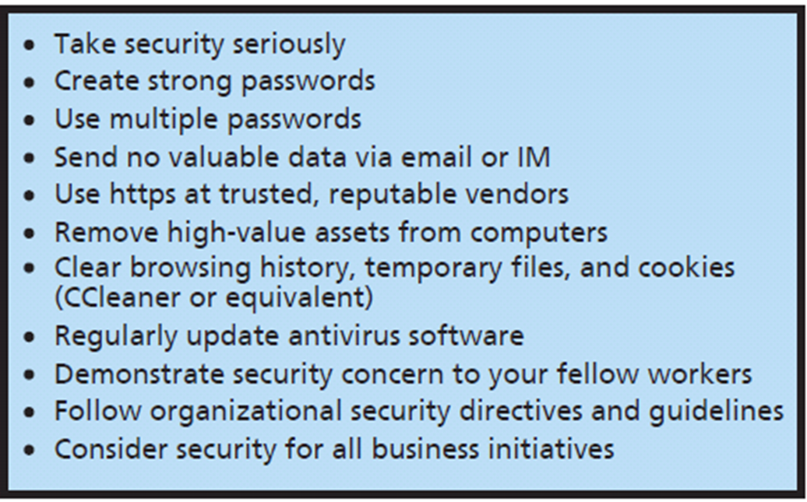
Q3: How Should You Respond to Security Threats?
Personal Security Safeguards
Intrusion detection system (IDS)
Notes:
Computer security professionals run intrusion detection systems to detect attacks.
An intrusion detection system (IDS) is a computer program that senses when another computer is attempting to scan or access a computer or network.
IDS logs can record thousands of attempts each day.

Slide 17
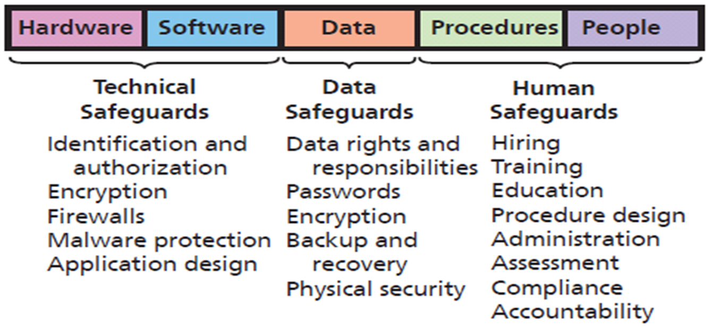
Security Safeguards and the Five Components
Notes:
An easy way to remember information systems safeguards is to arrange them according to the five components of an information system.

Slide 18
So What? New from Black Hat 2014
Educational forum for hackers, developers, manufacturers, and government agencies
Briefings on how things can be hacked
Show how to exploit weaknesses in hardware, software, protocols, or systems from smartphones to ATMs
Notes:
NSA Spying, Custom Spear-phishing, Botnets from Browsers, Hacking an iPhone.

Slide 19
Keynote Speaker Recommendations
Mandatory reporting of security vulnerabilities
Software makers liable for damage their code causes after abandoned or users allowed to see it
ISP liable for harmful, inspected content
“Right to be forgotten” - appropriate and advantageous
End-to-End Encrypted Email
Notes:
Black Hat was the keynote speech by In-Q-Tel CISO Dan Geer.

Slide 20
Hacking Smart Things
Automobile wireless features and poor internal systems architecture allow hackers to access automated driving functions through features like car’s radio
Control hotel lights, thermostats, televisions, and blinds in 200+ rooms by reverse-engineering home automation protocol called KNX/IP
70% smart devices use unencrypted network services, 60% vulnerable to persistent XSS (cross-site scripting), and weak credentials

Slide 21
Q4: How Should Organizations Respond to Security Threats?
Senior management creates company-wide policies:
What sensitive data will be stored?
How will data be processed?
Will data be shared with other organizations?
How can employees and others obtain copies of data stored about them?
How can employees and others request changes to inaccurate data?
Senior management manages risks
Notes:
Specifics of a policy depend on whether the organization is governmental or nongovernmental, publically held or private, organization’s industry, relationship of management to employees, and other factors.
Senior management must establish company-wide security policies.
Senior management security function is to manage risk.

Slide 22
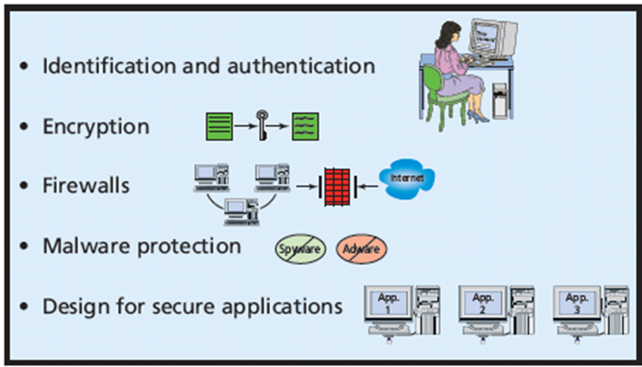
Q5: How Can Technical Safeguards Protect Against Security Threats?
Notes:
Technical safeguards involve the hardware and software components of an information system.
Single Sign-on for Multiple Systems

Slide 23
Technical safeguards
Identification and authentication
Smart Cards
Biometric authentication
Single sign-on for multiple systems
Encryption
Symmetric encryption
Asymmetric encryption
Public key encryption - special version

Slide 24
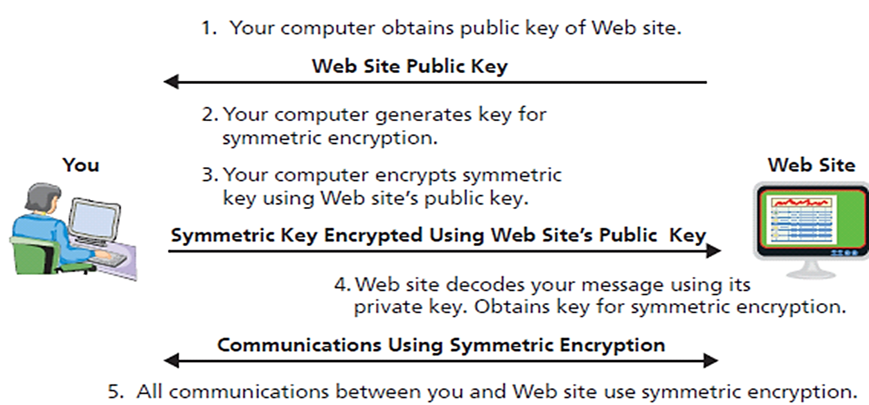
Essence of https (SSL or TLS)
Notes:
Summary of how SSL/TLS works when you communicate securely with a Web site:
1. Your computer obtains public key of Web site to which it will connect.
2. Your computer generates a key for symmetric encryption.
3. Your computer encodes key using Web site’s public key, then sends encrypted symmetric key to Web site.
4. Web site decodes symmetric key using its private key.
5. Now, your computer and Web site communicate using symmetric encryption.
Note: With asymmetric encryption, two keys are used; one key encodes the message, and the other key decodes the message. Symmetric encryption is simpler and much faster than asymmetric encryption.

Slide 25
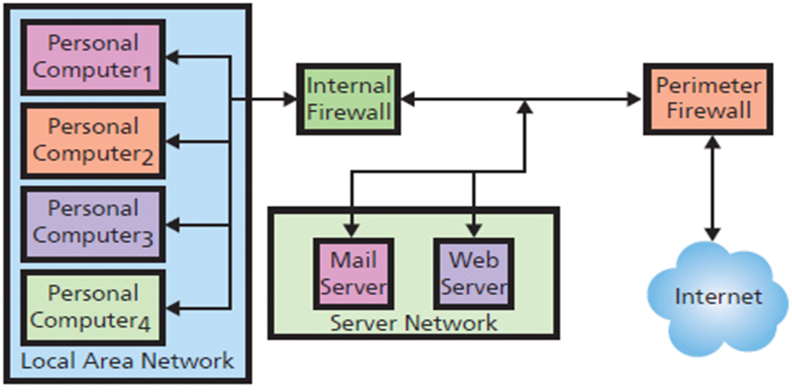
Use of Multiple Firewalls
Packet-filtering Firewall
Notes:
Organizations normally use multiple firewalls. Perimeter firewall sits outside organizational network; is first device that Internet traffic encounters.
Packet-filtering firewall examines each part of a message and determines whether to let that part pass. To make this decision, it examines source address, destination address(es), and other data. Packet-filtering firewalls can prohibit outsiders from starting a session with any user behind firewall, prohibit traffic from legitimate, but unwanted, addresses, such as competitors’ computers, and filter outbound traffic.
No computer should connect to the Internet without firewall protection. Many ISPs provide firewalls for their customers. By nature, these firewalls are generic. Large organizations supplement such generic firewalls with their own. Most home routers include firewalls, and Microsoft Windows has a built-in firewall as well. Third parties also license firewall products.

Slide 26
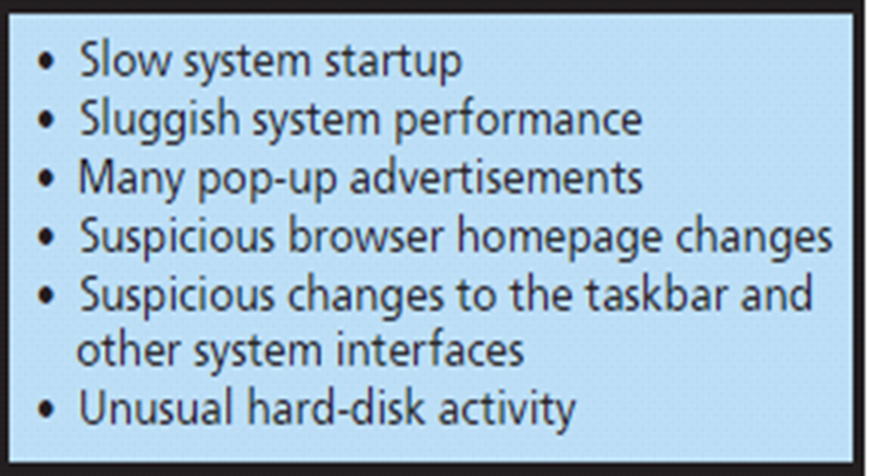
Malware Types and Spyware and Adware Symptoms
Viruses
Payload
Trojan horses
Worms
Spyware
Adware
Notes:
Payload is program code that causes unwanted activity. It can delete programs or data, or modify data in undetected ways.
Spyware programs are installed on the user’s computer without the user’s knowledge or permission. It resides in background and, unknown to the user, observes user’s actions and keystrokes, monitors computer activity, and reports the user’s activities to sponsoring organizations.
Some malicious spyware, called key loggers, captures keystrokes to obtain usernames, passwords, account numbers, and other sensitive information. Other spyware supports marketing analyses such as observing what users do, Web sites visited, products examined and purchased, and so forth.
Most adware is benign in that it does not perform malicious acts or steal data. It does, however, watch user activity and produce pop-up ads. Adware can also change the user’s default window or modify search results and switch the user’s search engine.

Slide 27
Malware Safeguards
Install antivirus and antispyware software
Scan your computer frequently
Update malware definitions
Open email attachments only from known sources
Promptly install software updates from legitimate sources
Browse only reputable web sites

Slide 28
Design for Secure Applications
SQL injection attack
User enters SQL statement into a form instead of a name or other data
Accepted code becomes part of database commands issued
Improper data disclosure, data damage and loss possible
Well designed applications make injections ineffective
Notes:
PRIDE with security in mind; PRIDE will store users’ privacy settings in a database, and it will develop all applications to first read the privacy settings before revealing any data in exercise reports. Most likely, PRIDE will design its programs so that privacy data is processed by programs on servers, which means data need be transmitted over the Internet only when it is created or modified.

Slide 29
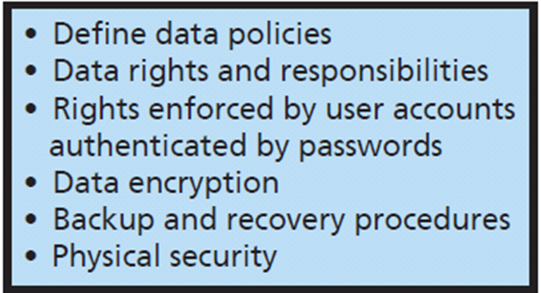
Q6: How Can Data Safeguards Protect Against Security Threats?
Data safeguards
Data administration
Key escrow
Notes:
Data safeguards protect databases and other organizational data. Two organizational units are responsible for data safeguards.
Data administration refers to an organization-wide function that is in charge of developing data policies and enforcing data standards.
When organizations store databases in the cloud, all of the safeguards should be part of the service contract.
Trusted party should have a copy of encryption key - called key escrow.

Slide 30
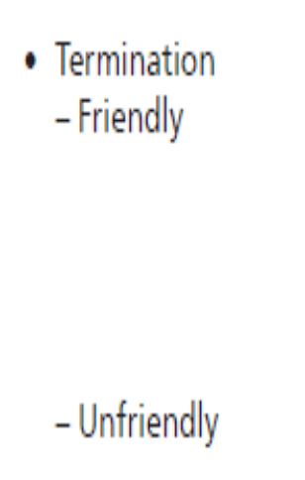
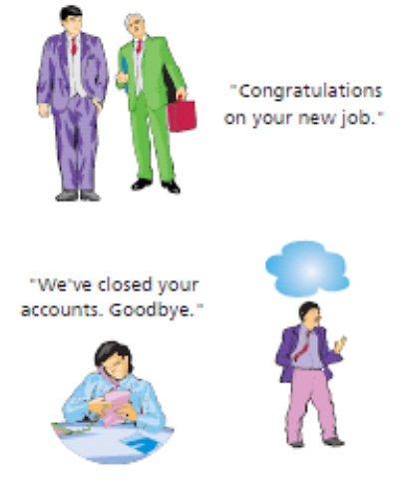
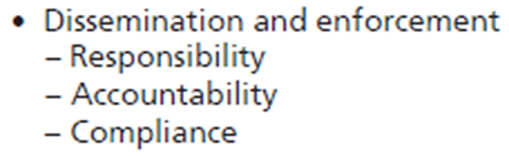
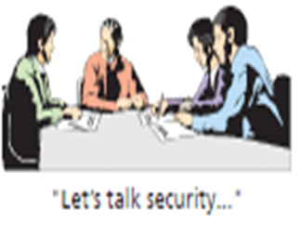
Q7: How Can Human Safeguards Protect Against Security Threats?
Notes:
Development of human safeguards for employees.
Employees need to be made aware of the security policies, procedures, and responsibilities they will have.
Companies must establish security policies and procedures for the termination of employees.

Slide 31
Human Safeguards for Nonemployee Personnel
Temporary personnel, vendors, partner personnel (employees of business partners), and public
Require vendors and partners to perform appropriate screening and security training
Contract specifies security responsibilities
Least privilege accounts and passwords, remove accounts as soon as possible

Slide 32
Public Users
Web sites and other openly accessible information systems.
Hardening
Special versions of operating system that lock down or eliminate operating systems features and functions not required by application
Protect public users from internal company security problems

Slide 33
Account Administration
Account Management
Standards for new user accounts, modification of account permissions, removal of unneeded accounts
Password Management
Users change passwords frequently
Help Desk Policies
Provide means of authenticating users
Notes:
Account management
Create new user accounts, modify existing account permissions, remove unneeded accounts. Improve your relationship with IS personnel by providing early and timely notification of needed account changes.
Password management
Users should change passwords every 3 months or less.
Help desk management
Set policy for means of authenticating a user.

Slide 34
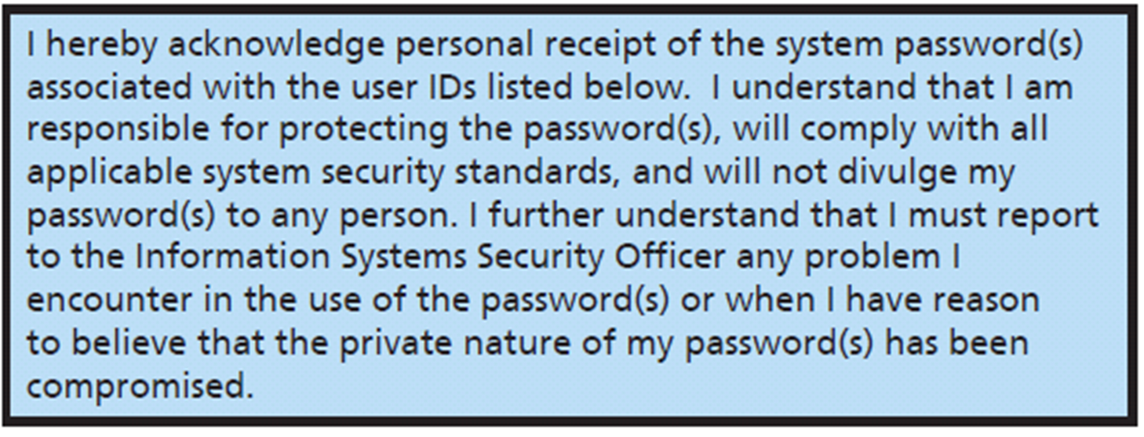
Sample Account Acknowledgment Form
Notes:
Employees required to sign statements similar to this.

Slide 35
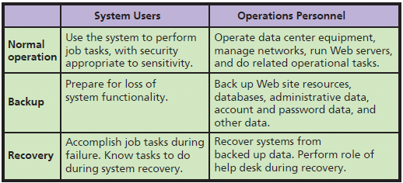
Systems Procedures
Notes:
Definition and use of standardized procedures reduces likelihood of computer crime and other malicious activity by insiders. It also ensures system’s security policy is enforced.

Slide 36
Security Monitoring
Activity logs
Firewall log
Lists of all dropped packets, infiltration attempts, unauthorized access, attempts from within the firewall
DBMS
Successful and failed logins
Web servers
Voluminous logs of Web activities
PC O/S produce logs of log-ins and firewall activities

Slide 37
Security Monitoring (cont’d)
Employ utilities to assess their vulnerabilities
Honeypots for computer criminals to attack
Investigate security incidents
Constantly monitor existing security policy and safeguards

Slide 38
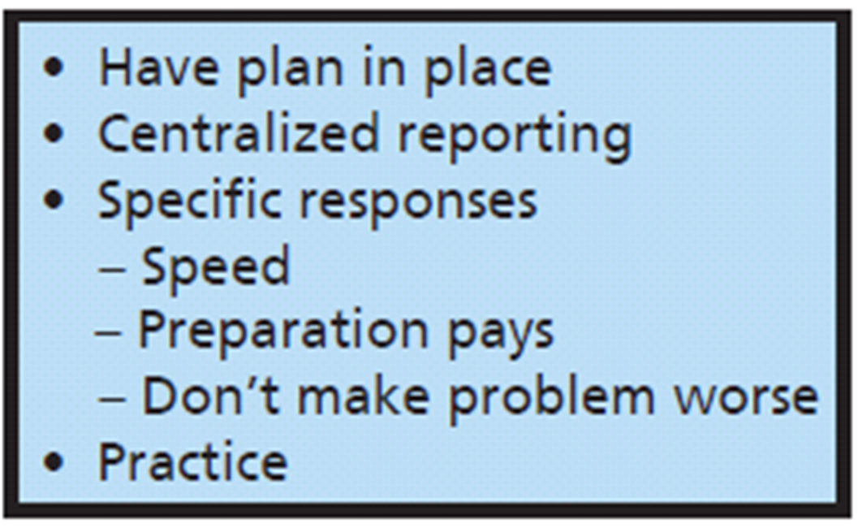
Q8: How Should Organizations Respond to Security Incidents?
Notes:
Every organization should have an incident-response plan as part of the security program. No organization should wait until some asset has been lost or compromised before deciding what to do.
The plan should include how employees are to respond to security problems, whom they should contact, the reports to make, and steps to reduce further loss.
Identify critical personnel and their off-hours contact information

Slide 39
How Does the Knowledge in This Chapter Help You?
Awareness of:
Threats to computer security as an individual, business professional, employer
Risk trade offs
Technical, data, human safeguards to protect computing devices and data
How organizations should respond to security threats
How organizations should respond to security incidents
Importance of creating and using strong passwords!

Slide 40
Ethics Guide: Hacking Smart Things
Unintended risks associated IoT
26 billion IoT devices by 2020
Hackers access automated driving functions through features like car’s radio
Via automobile wireless features with poor internal systems architecture
Control hotel lights, thermostats, televisions, room blinds by reverse-engineering home automation protocol (KNX/IP)

Slide 41
Ethics Guide: Hacking Smart Things
Threats to securing home, appliances, your car
70% smart devices use unencrypted network services
60% vulnerable to persistent XSS (cross-site scripting) and weak credentials

Slide 42
Guide: EMV to the Rescue
EMV chip-and-PIN.
Changes way cards are verified
Chip verifies authenticity of physical card, PIN verifies identity of cardholder
What EMV can do to protect you?
Notes:
Goal
Help students formulate personal principles with regard to security and privacy.
Understand the trade-off between security and freedom.
Make students aware of

Slide 43
Active Review
Q1: What is the goal of information systems security?
Q2: How big is the computer security problem?
Q3: How should you respond to security threats?
Q4: How should organizations respond to security threats?
Q5: How can technical safeguards protect against security threats?
Q6: How can data safeguards protect against security threats?
Q7: How can human safeguards protect against security threats?
Q8: How should organizations respond to security incidents?
How does the knowledge in this chapter help you?

Slide 44
Case Study 10: Hitting the Target
Lost 40 million credit and debit card numbers
Less than a month later, announced additional 70 million customer accounts stolen that included names, emails, addresses, phone numbers, etc
98 million customers affected
31% of 318 million in US
Stolen from point-of-sale (POS) systems at Target stores during holiday shopping season

Slide 45
Hitting the Target (cont’d)
Spear-phished third party vendor, Fazio Mechanical Services
Malware gathered keystrokes, login credentials, screenshots from Fazio users
Used stolen login credentials to access vendor server on Target’s network
Escalated privileges to gain access to Target’s internal network
Compromised internal Windows file server
Installed malware named Trojan.POSRAM

Slide 46
Hitting the Target (cont’d)
Customer data continuously sent from POS terminals to an extraction server within Target’s network
Funneled out of Target’s network to drop servers in Russia, Brazil, and Miami
Data sold on black market

Slide 47
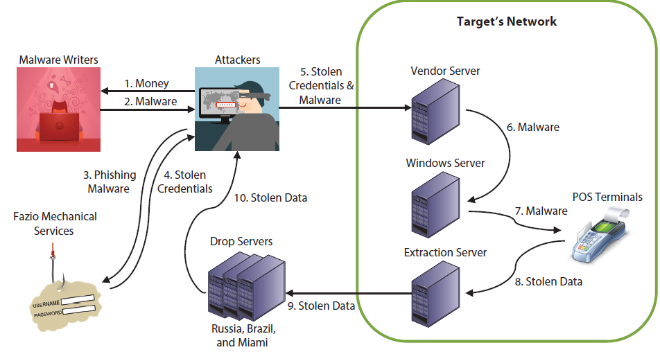
How Did They Do It?
Attackers escalated privileges to gain access to Target’s internal network.
Spearphished malware to gather keystrokes, login credentials,
and screenshots from Fazio users
Trojan.POSRAM extracted data
from POS terminals

Slide 48
Damage
Attackers sold about 2 million cards for $26.85 each ($53.7M)
Target took loss on merchandise purchased using stolen credit cards
Costs
Upgraded POS terminals to support chip-and-pin cards
Increased insurance premiums
Paid legal fees
Settled with credit card processors
Paid consumer credit monitoring
Paid regulatory fines

Slide 49
Damage (cont'd)
Target loss of customer confidence and drop in revenues (46% loss for quarter)
Direct loss to Target as high at $450 million
CIO resigned, CEO paid $16 million to leave
Cost credit unions and banks more than $200 million to issue new cards
Insurers demand higher premiums, stricter controls, more system auditing
Consumers must watch their credit card statements, and fill out paperwork if fraudulent charges appear

